Slide 1
Long Range Transportation Plans Region 5 and 7E
Image courtesy of MnDOT’s Mora Hwy 65 and Hwy 23 Corridor Study.

Slide 2
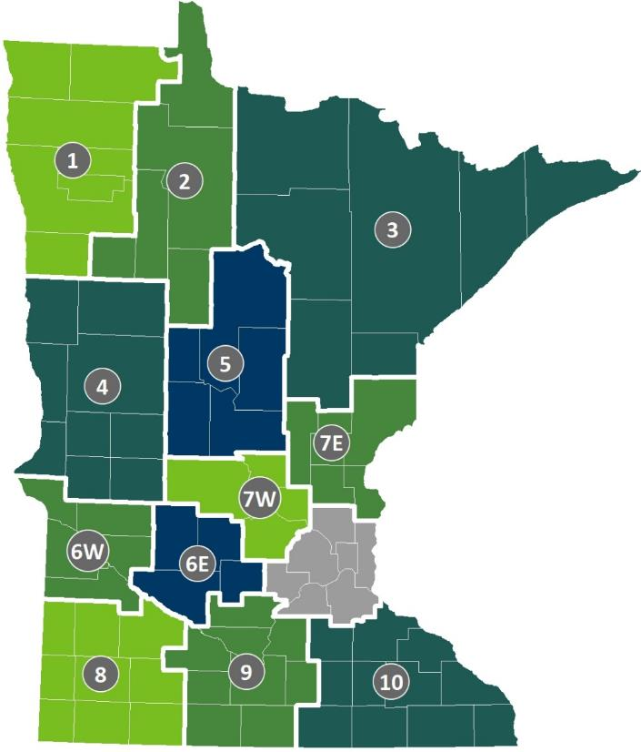
Project Overview
The Minnesota Department of Transportation (MnDOT) is assisting two regions with Long Range Transportation Plans:
Region 5
Region 7E
Long Range Transportation Plans establish a vision and corresponding set of transportation goals, objectives, strategies, and actions.

Slide 3
Regional Development Organizations
Regional Development Organizations assist with statewide transportation planning and programming.
Region 5 is represented by the Region Five Development Commission (R5DC).
Region 7E is represented by the East Central Regional Development Commission (ECRDC).

Slide 4
Project Goals
Coordinate with other state, regional, and local plans and with planned transportation investments.
Identify the regional transportation needs of stakeholder groups in each region.
Communicate regional transportation solutions with a focus on major roads and highways.
Offer strategies and policy recommendations to aid in the identification, prioritization, and implementation of future transportation projects.

Slide 5
Schedule

Slide 6
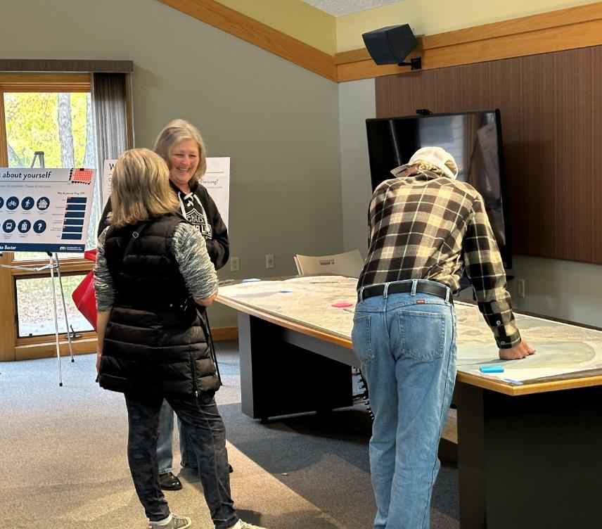
Community Engagement Strategies
Project staff will use the following strategies to collect feedback about transportation in the regions:
A project website that includes an online survey.
Meetings hosted in common gathering places.
Tabling at existing community events.
Small group discussions organized through local organizations.
Workshops with the Technical Advisory Committee.
Image courtesy of MnDOT’s Hwy 371 Nisswa to Baxter Corridor Study.

Slide 7
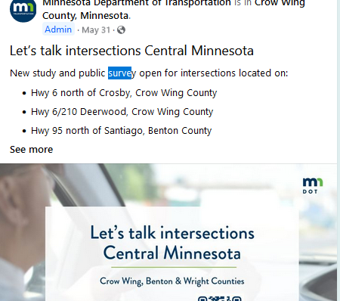
Promotional Strategies
To get the word out, we will use the following strategies:
MnDOT’s GovDelivery newsletter.
Posts on MnDOT’s Facebook and Twitter as well as paid Facebook advertisements.
Advertise on local newspaper websites.
Image courtesy of MnDOT District 3’s Facebook page.

Slide 8
Role of Scenic Byways
Master plans are being reviewed as part of existing conditions analysis.
Will influence formation of vision, goals, and objectives with Technical Advisory Committees.
Will be considered in project evaluation and prioritization.
Opportunity to identify policy needs or additional studies.

Slide 9
Contact Information
Tom Cruikshank
MnDOT Project Manager
thomas.cruikshank@state.mn.us
Austin Hauf
WSB Project Manager
ahauf@wsbeng.com
Tad Erickson
Region Five Development Commission
terickson@regionfive.org
Penny Simonsen
East Central Regional Development Commission
penny.simonsen@ecrdc.org

Slide 10
Thank you!
Image courtesy of MnDOT’s Mora Hwy 65 and Hwy 23 Corridor Study.

